Slide 1

Picture Learning

Slide 2
Introduction
Picture learning is a widely studied problem that deals with the ability of the machine to learn.
The learning of black-and-white images may be visualized as a classificatory problem where the x and y coordinates are given and the task is to classify that point into one of the two classes, black or white.
The algorithm that we develop and implement here uses clustering of the training data set. This limits the training data to a workable amount.
The problems also employ the concept of Hidden Markov Models. These are statistical models that can be used to predict the consequence of the unknown input.
Classification is a major problem of study that attracts immense interest because of its applicability.
Various other mathematical models have been proposed. These employ mathematical techniques like point-to-point matching to solv problems.

Slide 3
PICTURE LEARNING
This will give some background to the motivation behind our development of the algorithm and its use.
The machine is supposed to learn the picture. The machine makes use of learning techniques for this.
Once the system is trained, it becomes synonymous with the image. Now we may set aside the image, as it can be reproduced whenever required using the trained system.
Hence this method of picture learning can be used for image compression purposes.
At the time of testing or reproducing the image, the system is given all the points that lie on the picture as input one by one.
In these types of images, the output of the system is 1 or 0. In this way, the problem becomes classificatory in nature, where we have to classify each input in one of the two classes: 0 or 1.
We then use this algorithm over binary images and see how the machine is able to learn and redraw the image on being shown only some points in the image.

Slide 4
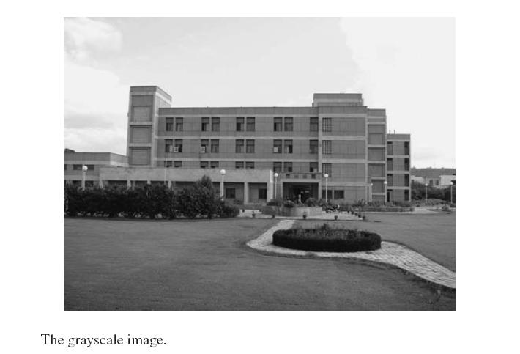
Coding Techniques
In this section we look at some of the fundamental techniques that are used for the coding purposes.

Slide 5
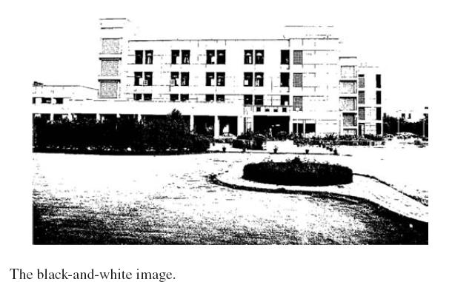
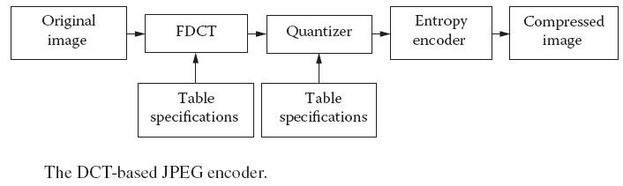
Coding Techniques
These levels are decided using a codebook that is defined externally. The Euclidian norm is commonly used to decide the levels.

Slide 6
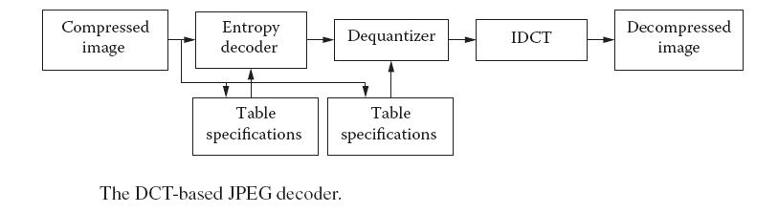
JPEG Compression
JPEG stands for Joint Photographic Experts Group. It is a joint standard for image compression developed by the ISO and CCITT.
The format has specifications for the way the image is compressed, stored, and later decompressed.
The DCT-based encoder and decoder of the JPEG system are shown in Figures 16.2 and 16.3 respectively.
Here first decoding takes place, followed by dequantization and inverse DCT operation. This finally gives us the original image back, with a little loss of information.

Slide 7
Soft Computing App roac hes
From the previous discussions, you can easily see the usefulness of soft computing techniques for image compression and learning.
Their use in the particular technique may be easily visualized and appreciated.
All these techniques give great results when applied to the compression of images.
These also give good results when applied to most images. Various hybrid techniques are also applied to image compression.

Slide 8
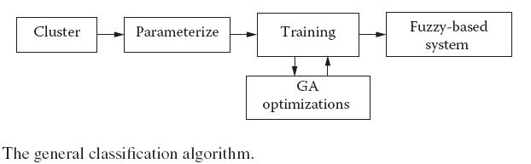
HYBRID CLASSIFIER BASED ON NEURO-FUZZY SYSTEM
The whole architecture and problem-solving methodology of this system is based on the neuro-fuzzy architecture.
Every step that we take in this algorithm will be handled separately for each and every class.
In this algorithm, the first task is to cluster the input data set into clusters. The clusters, as we shall see later in the text, are class specific.
The whole process of the algorithm is shown in Figure 16.4.

Slide 9
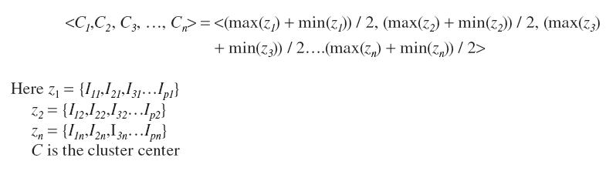
Clustering
Clustering is the very first step that is performed in the algorithm. The clustering is useful for limiting the amount of data.
We introduce a major constraint in the clustering algorithm. Usually the clusters are made on the basis of the input data only.
Suppose the input space was an n-dimensional space in which the training data in a particular cluster are placed at
The center for this data is given by Equation 16.1.

Slide 10
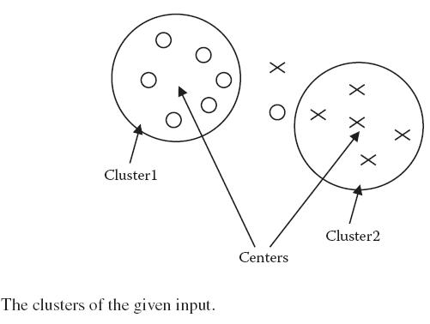

Clustering
We define the radius of the cluster as the square of distance between the center of the cluster and the most distant point in the cluster. Hence the radius of the cluster can be written as

Slide 11


Clustering
In other words, there should be no foreign member in the cluster. Hence for any input
in the system that belongs to a different class, Equation 16.3 must always be false.
The net influence of the class is calculated using this constant parameter called firing power and denoted by P. The formula is given by Equation 16.4.
P = a R
Here a is const R is radius of the graph P is the power

Slide 12
Clustering
Cluster()
Step 1: While all points are not clustered
Do
Step 2: Add any random point to a new cluster
Step 3: While it is possible to add new points in this new cluster
Do
Step 4: Search for the point p that is closest to any point in the cluster
Step 5: If cluster formed by adding p to this cluster is possible then add p to new cluster
Step 6: Find center and initial power of this cluster

Slide 13



Fuzzy Logic
Here we make use of the summarized data items from the training data that we receive from clustering algorithm.
As per the basic motive of the algorithm, this process of application of fuzzy logic is class specific.
This way, the rules are class specific. The output of the rule is given by Equation 16.5.
Here Oi is the influence of the individual rule for cluster i in favor of its class c Pi is the firing power of the cluster i Di is the square of distance between the center of cluster i and the given input
final influence for any specific class is given by Equation 16.6:
The final output is the class corresponding to the maximum influence.

Slide 14
Network Training
One was the firing power, which played the role of weights in a conventional fuzzy system.
The training is performed in a batch processing style where the various training data sets are fed one after the other.
If the difference is large, the change is large, and vice versa following the steepest descent approach.
In this system, the training data set is used by the clustering algorithm to cluster and give the cluster representatives that serve as rules.
The parameter modification modifies the center and the firing power of every cluster.

Slide 15
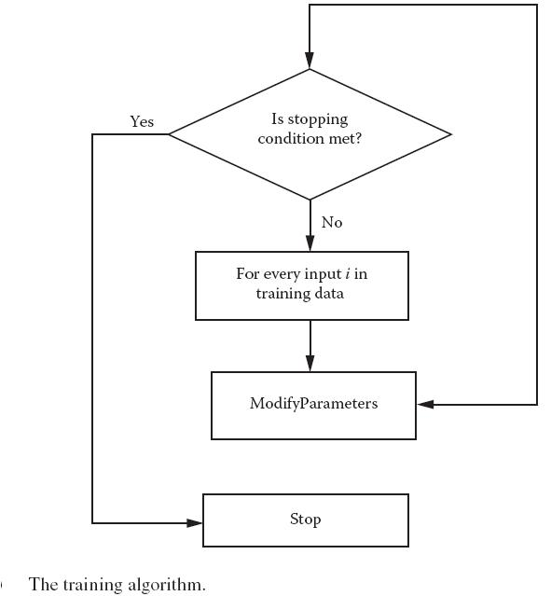
Network Training

Slide 16
Network Training
It sees whether the class to which the cluster being considered belongs is same as the class of the training data being considered.
The rate of increase or decrease of the contribution depends on the distance between the training data and the cluster being considered.
The change or modification in weight is class specific, where every change happens by considering its class.
We take the difference between the influence of the desired class and the class that wins the competition.
The change is multiplied by learning rate that does the same job as it did in the ANNs.
The learning rate may be changed as needed. It may be fixed or made variable as per the training strategy.

Slide 17
Network Training
ModifyParameters
Step 1: For every cluster c in sample space
Do
Step 2: a1 ← contribution of desired output class in deciding final answer
Step 3: a2 ← contribution of class c if different from desired output class else contribution of second highest contributing class for the fina output
Step 4: if desired class = c
Step 5: With a probability of 0.5 increase its power by K percent
Step 6: With a probability of 0.5 move center closer to the given input by C percent
else
Step 7: With a probability of 0.5 decrease its power by K percent
Step 8: With a probability of 0.5 move center away from given input by C percent

Slide 18
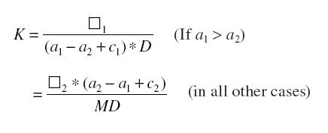

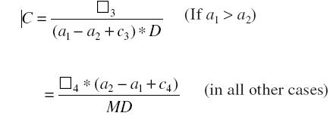
Network Training
The increase/decrease in percent in power is given by Equation 16.8.
Where K is the percent change in firing power D is the distance between input and cluster being considered (c) M is the maximum distance between any two points in the n-dimensional space
The percent increase/decrease in center is given by Equation 16.9:

Slide 19

Network Training
Where K is the percent change in firing power
D is the distance between input and cluster being considered (c)
M is the maximum distance between any two points in the n-dimensional space
Genetic Algorithms
The role of GA is to generate diversities and help avoid the local minima that would have occurred if only ANN training was used. The GA combined various semitrained networks to generate more networks.
This further helps the algorithm explore the entire search space and converge at the local minima.

Slide 20
PICTURE LEARNING USING THE ALGORITHM
The algorithm was given a part of small black-andwhite picture.
The selected pixels were later divided into training data sets and validating data sets.
This even tested the generalizing capability of the system, where the system had to predict the output at the completely unknown inputs.
It can be easily seen that the efficiency improves as a result of each and every step that was discussed in the algorithm.
The same problem was also tried to be solved by a neural network and a conventional neuro-fuzzy system.
Hence it can be easily inferred from the results that the neuro-fuzzy system that we have proposed here gives the best results as compared to the other systems.

Slide 21
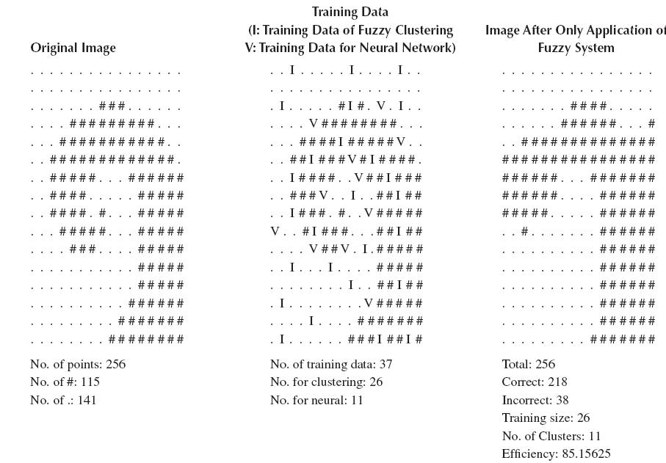
Results of the Algorithm in the Problem of Picture Learning

Slide 22
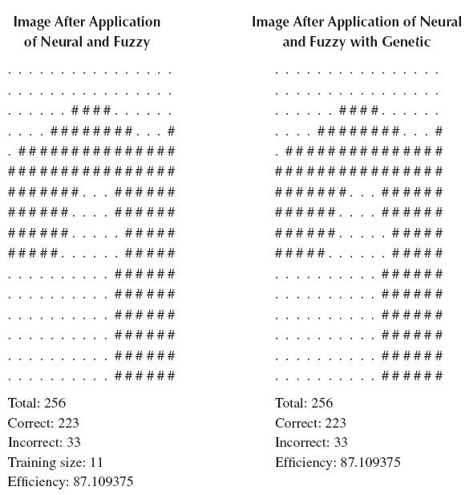
Results of the Algorithm in the Problem of Picture Learning

Slide 23
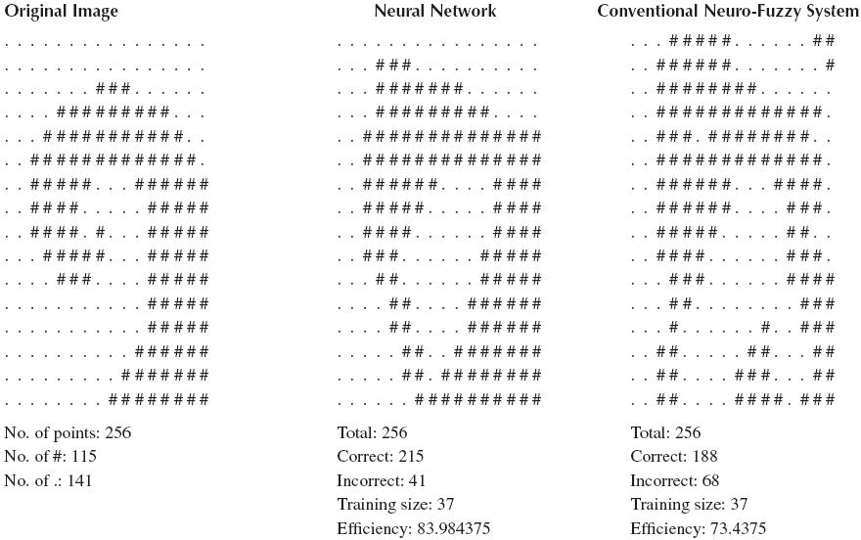
Results of the Conventional Classifiers in the Problem of Picture Learning

Slide 24
INSTANTANEOUSLY LEARNING NEURAL NETWORK
We have discussed over and over again in the text the power of ANN to learn the past data and to generalize the learned data to effectively apply to the unknown inputs.
In this section we develop a system that is much faster in training of the system. This is the special class of ANNs that are called the instantaneously trained ANNs.
These ANNs train themselves very fast with a loss in generality. They are inspired by human short-term memory.
Next were the CC4 algorithms, which are the most advanced; they place some conditions on the inputs but give good generalizations. We will mainly study the CC4 algorithm in this section.
We first present the CC4 algorithm. Then we study the complex input coding that includes the binary and quaternary encoding. After that, we present the instantaneous training of ANNs. Finally we discuss the ACC algorithm.

Slide 25
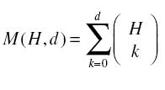
CC4 Algorithm
The CC4 is an advanced algorithm that is used for its high classificatory powers and fast training.
The CC4 algorithm takes the same ANN architecture as used by the other corners algorithms.
The CC4 algorithm uses a concept of radius of generalization that is essentially a generalization control.
Corners Algorithm
The basic principle used behind these algorithms is the Corners Theorem, which states that the minimum number of hidden neurons H required to separate M number of regions in a d-dimensional space is given by Equation 16.10.

Slide 26



Corners Algorithm
Let the number of regions that the hidden neurons separate be equal to C, where C ≤ M. Since number of classes at output is 2, these C regions coalesce into the two classes at output.
Not every dimension may require the same precision.
If the number of training samples is T, then M ≤ T, for d – 1, H is given by Equation 16.12.

Slide 27
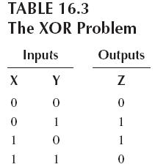
Learning
Learning in these ANNs is just by inspection of the weights. We consider the case when there is only one output class for simplicity.
We added another additional input to the system. At the end we set its weight to r – s + 1. Here r is a parameter that is called as the radius of generalization, and s is the number of 1s in the corresponding input (Ii).
Here we fix the value of the radius of generalization, r, to be 0. The final structure of the ANN is shown in Figure 16.7.
It may be verified that it gives correct output for all the inputs when presented during testing.

Slide 28
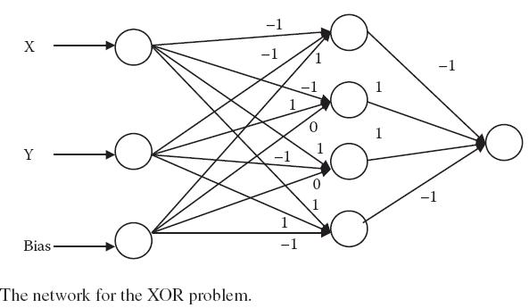
Input Encoding
We know that in these systems we have the restriction that the input has to be binary always.
Hence we adopt a different strategy. We fix the length of the inputs to the maximum input possible. The input now contains a series of 1s.
This is thus a much more compact form of representation.

Slide 29
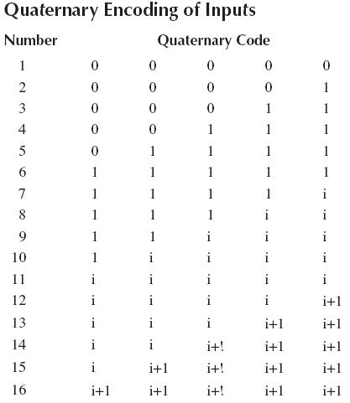

Input Encoding
These consist of only 1 and i. Similarly the next set of inputs is L in number and ranges from 2L + 2 to 3L + 1. It may be seen that
L can be calculated by using Equation 16.13.

Slide 30
Modifications for Complex Inputs
In this section we mention the modifications that need to be carried out in the CC4 algorithm to enable it work with complex inputs.
Just like 0 and 1, the inputs i and i + 1 work in pairs. Here i is considered to be a low input (analogous to 0) and i + 1 is considered to be a high input (analogous to 1).
Again suppose that we apply an input from the training data set. Here each input is multiplied with its corresponding weight; 0 multiplies with –1 to give 0.
For some inputs it might be possible for two neurons to be simultaneously active, depending upon the inputs and weights.
The network architecture of the resulting ANN is shown in Figure 16.8. Here r is kept to be 0, since no generalization is needed.
The inputs and outputs at the various layers are given in Table 16.6.

Slide 31
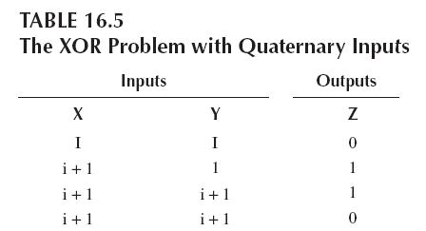
Restrictions on Inputs
It was discussed earlier that some inputs may activate more than one hidden layer of neurons. This is an undesirable property for the network.
If an m element vector with n wholly real high and n wholly real low elements is given as an input, then another m element vector with n wholly complex high and n wholly complex low elements cannot be given as an input, if these high and low elements of

Slide 32
Restrictions on Inputs
both the vectors appear in the same positions, while all other m – 2n elements of both the vectors are identical. E.g., the following pairs are illegal as input: …1…0… and ….1 + i…i… , …i…1 + i… and …0…1….
If an m element vector with n complex high elements is given as an input, n being even, then another m-element vector with n / 2 real high elements and n / 2 complex low elements in the same position as the n complex high elements of the first vector cannot be given as an input, if all the other m – n elements of both the vectors are identical. E.g., the following pairs are illegal as input: …1 i 1 i… and …1 + i 1 + i 1 + i 1 + i …, …1 + i 1 + i 1 + i 1 + i… and …1 i 1 i …

Slide 33
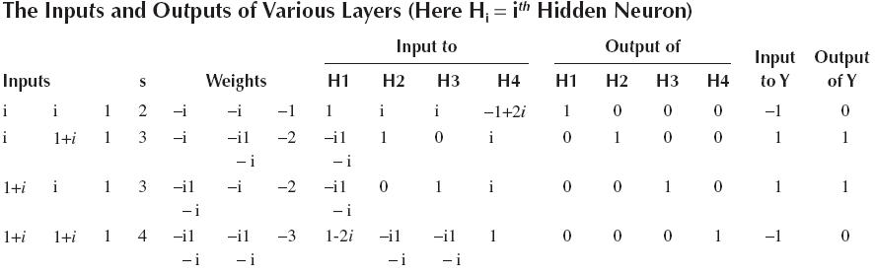
ACC Algorithm
The advanced corner classification (ACC) algorithm removes the restrictions on inputs that were placed by the CC4 algorithm.
The rest of the architecture and working of the ACC is similar to that of the CC4 algorithm.

Slide 34
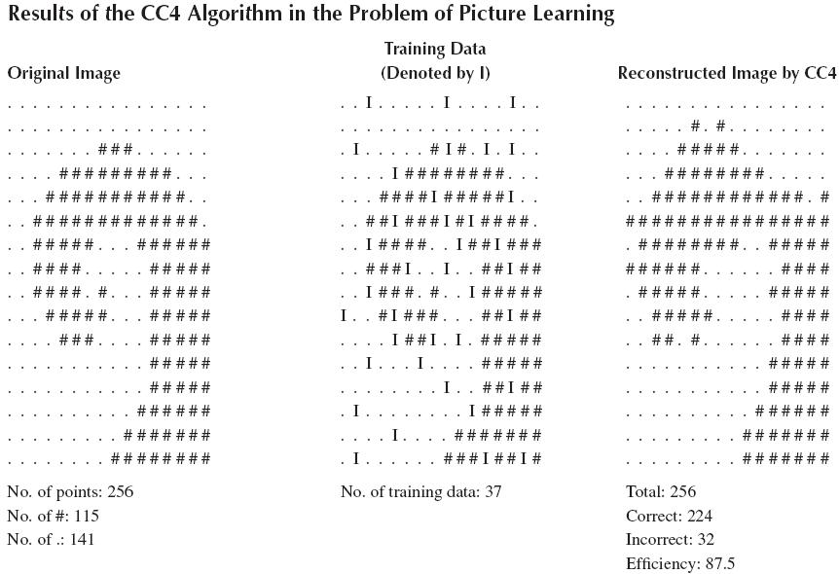
ACC Algorithm

Slide 35
PICTURE LEARNING
In this section we use the CC4 algorithm for solving the same problem of picture learning as we had done in the preceding section with the built hybrid algorithm using a neuro-fuzzy architecture.
The original picture, the training points, and the reconstructed picture by the algorithm is given in Table 16.7.
Since we are not showing the entire picture to the algorithm, generalization is needed.
Recall that since these are instantaneously trained ANNs, they require much smaller training time but much larger memory for solving the problem as compared to the previously discussed hybrid method or any of the generally known mechanisms.
The efficiency of 87.5 percent shows the generalizing and the learning capabilities of these ANNs.

Slide 36
CONCLUSION
In this chapter we first introduced picture learning. We saw the various phases and mechanisms of picture learning.
Late in the chapter we developed a model that could solve the classificatory problems. We made an algorithm inspired by the neuro-fuzzy architecture.
We got a good efficiency, 87 percent, which shows the impact of the algorithm.
We studied the CC4 algorithm, which was a good means to solve the classificatory problem where all inputs and outputs could be represented in binary numbers.
The model can be improved by adapting the mathematical model more according to the problem.
Also there must be mechanisms to limit the memory requirement of these algorithms, as in many real-life applications the training data set size might be too large.

